Slide 1
Topic: Right-Angled Triangles
EQ – How do we find the length of a side of a right angled triangle using trigonometry ratios?

Slide 2
Learning Intentions
Students will be able to
- use trigonometry to find the length of an unknown side

Slide 3
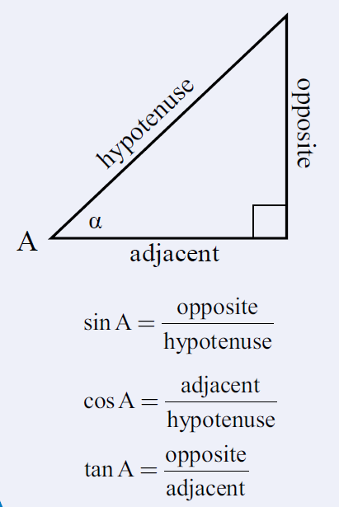
24
7
30
Date:
Right-Angled Triangles
EQ – How do we find the length of a side of a right angled triangle using trigonometry ratios?
We will be using these ratios to find an unknown side of a right angled triangle.
What are the trigonometry ratios?

Slide 4
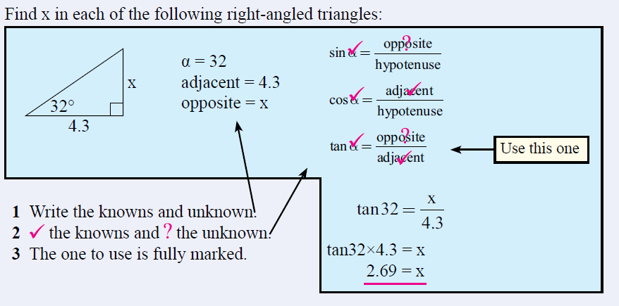
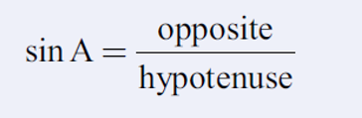
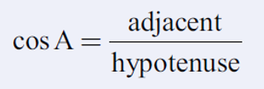


24
7
30
Date:
Right-Angled Triangles
EQ – How do we find the length of a side of a right angled triangle using trigonometry ratios?
How do I use the tangent ratio to find a missing side?

Slide 5
Ex: 1 Figure out which ratio to use. Find x. Round to the nearest tenth.
20 m
x
20
tan
55
)
Now, figure out which trig ratio you have and set up the problem.

Slide 6
Ex: 2 Find the missing side. Round to the nearest tenth.
80 m
x
80
÷
(
tan
72
)
)
=
Now, figure out which trig ratio you have and set up the problem.

Slide 7
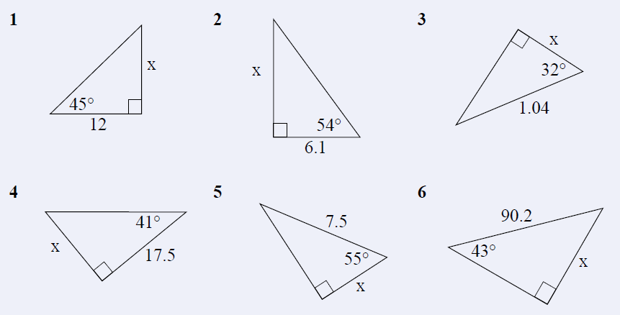
Task

Slide 8
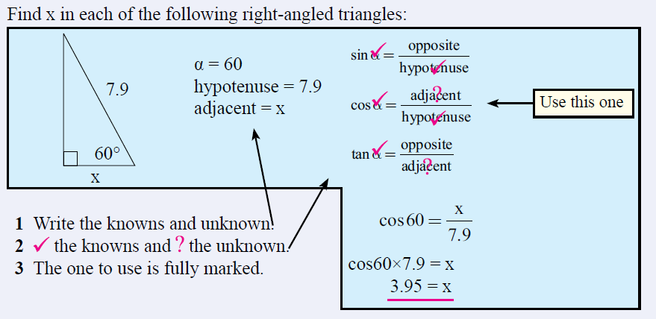
24
7
30
Date:
Right-Angled Triangles
EQ – How do we find the length of a side of a right angled triangle using trigonometry ratios?
How do I use the cosine ratio to find a missing side?

Slide 9
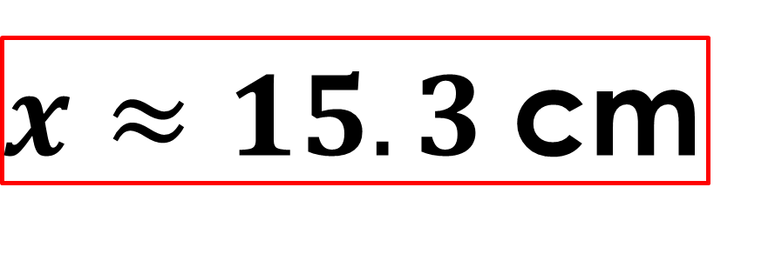
Ex: 3 Find the missing side. Round to the nearest tenth.
20 cm
x
$x≈15.3$cm

Slide 10
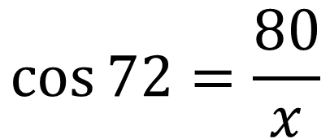
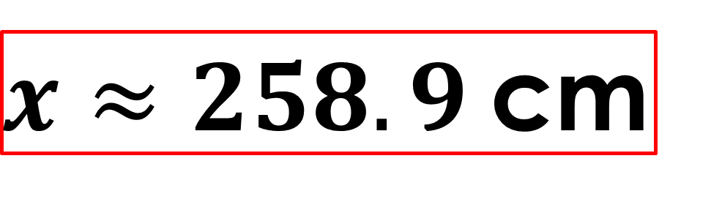


Ex: 2 Find the missing side. Round to the nearest tenth.
$$\cos{72}=\frac{80}{x}$$
80 m
$$x=80÷ cos{72}$$
$$x=258.8854382$$
x
80
÷
(
cos
72
)
)
=
Shrink yourself down and stand where the angle is.
$x≈258.9$cm
Now, figure out which trig ratio you have and set up the problem.

Slide 11
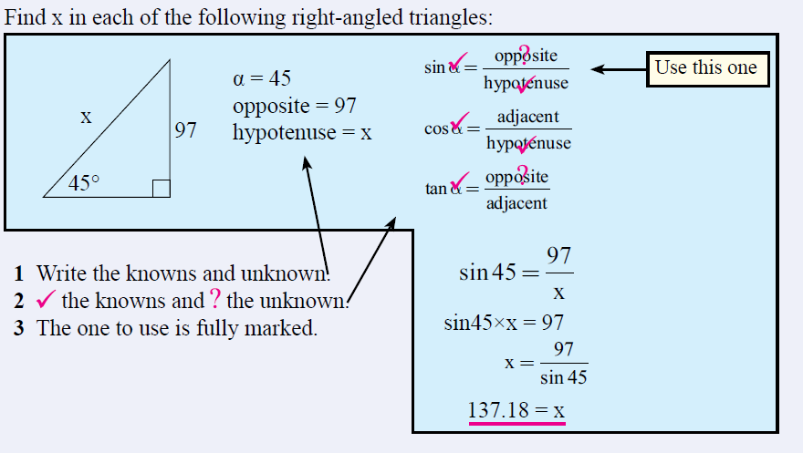
24
7
30
Date:
Right-Angled Triangles
EQ – How do we find the length of a side of a right angled triangle using trigonometry ratios?
How do I use the sine ratio to find a missing side?

Slide 12
Ex: 3 Find the missing side. Round to the nearest tenth.
283 m
x
Now, figure out which trig ratio you have and set up the problem.

Slide 13


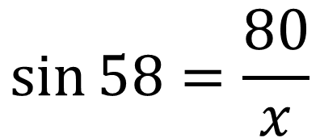

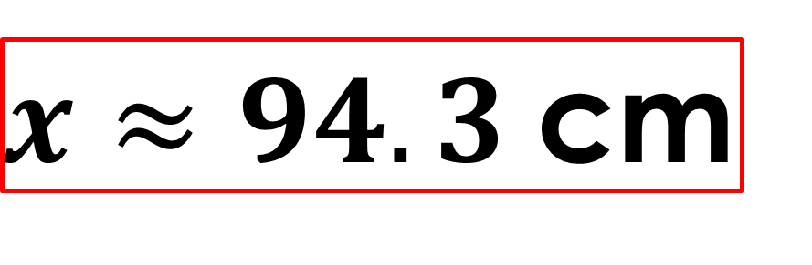
Ex: 2 Find the missing side. Round to the nearest tenth.
$$\sin{58}=\frac{80}{x}$$
80 m
$$x=80÷ sin{58}$$
$$58°$$
$$x=94.33427227$$
x
80
÷
(
sin
58
)
)
=
$x≈94.3$cm
Now, figure out which trig ratio you have and set up the problem.

Slide 14
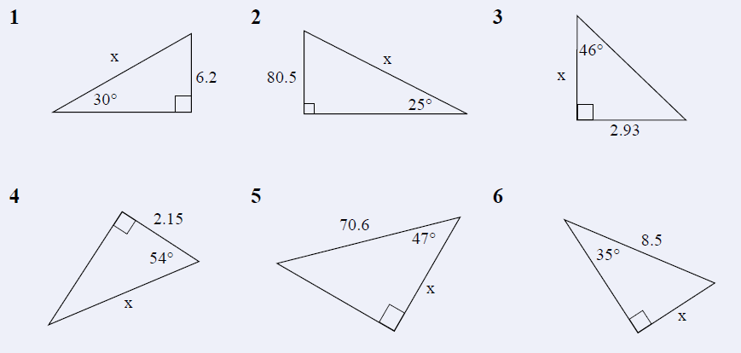
Task

Slide 15
Early Finishers: Black MAWA textbook p 68 Q6, 7 Black MAWA textbook p 74 Q5

